Slide 1
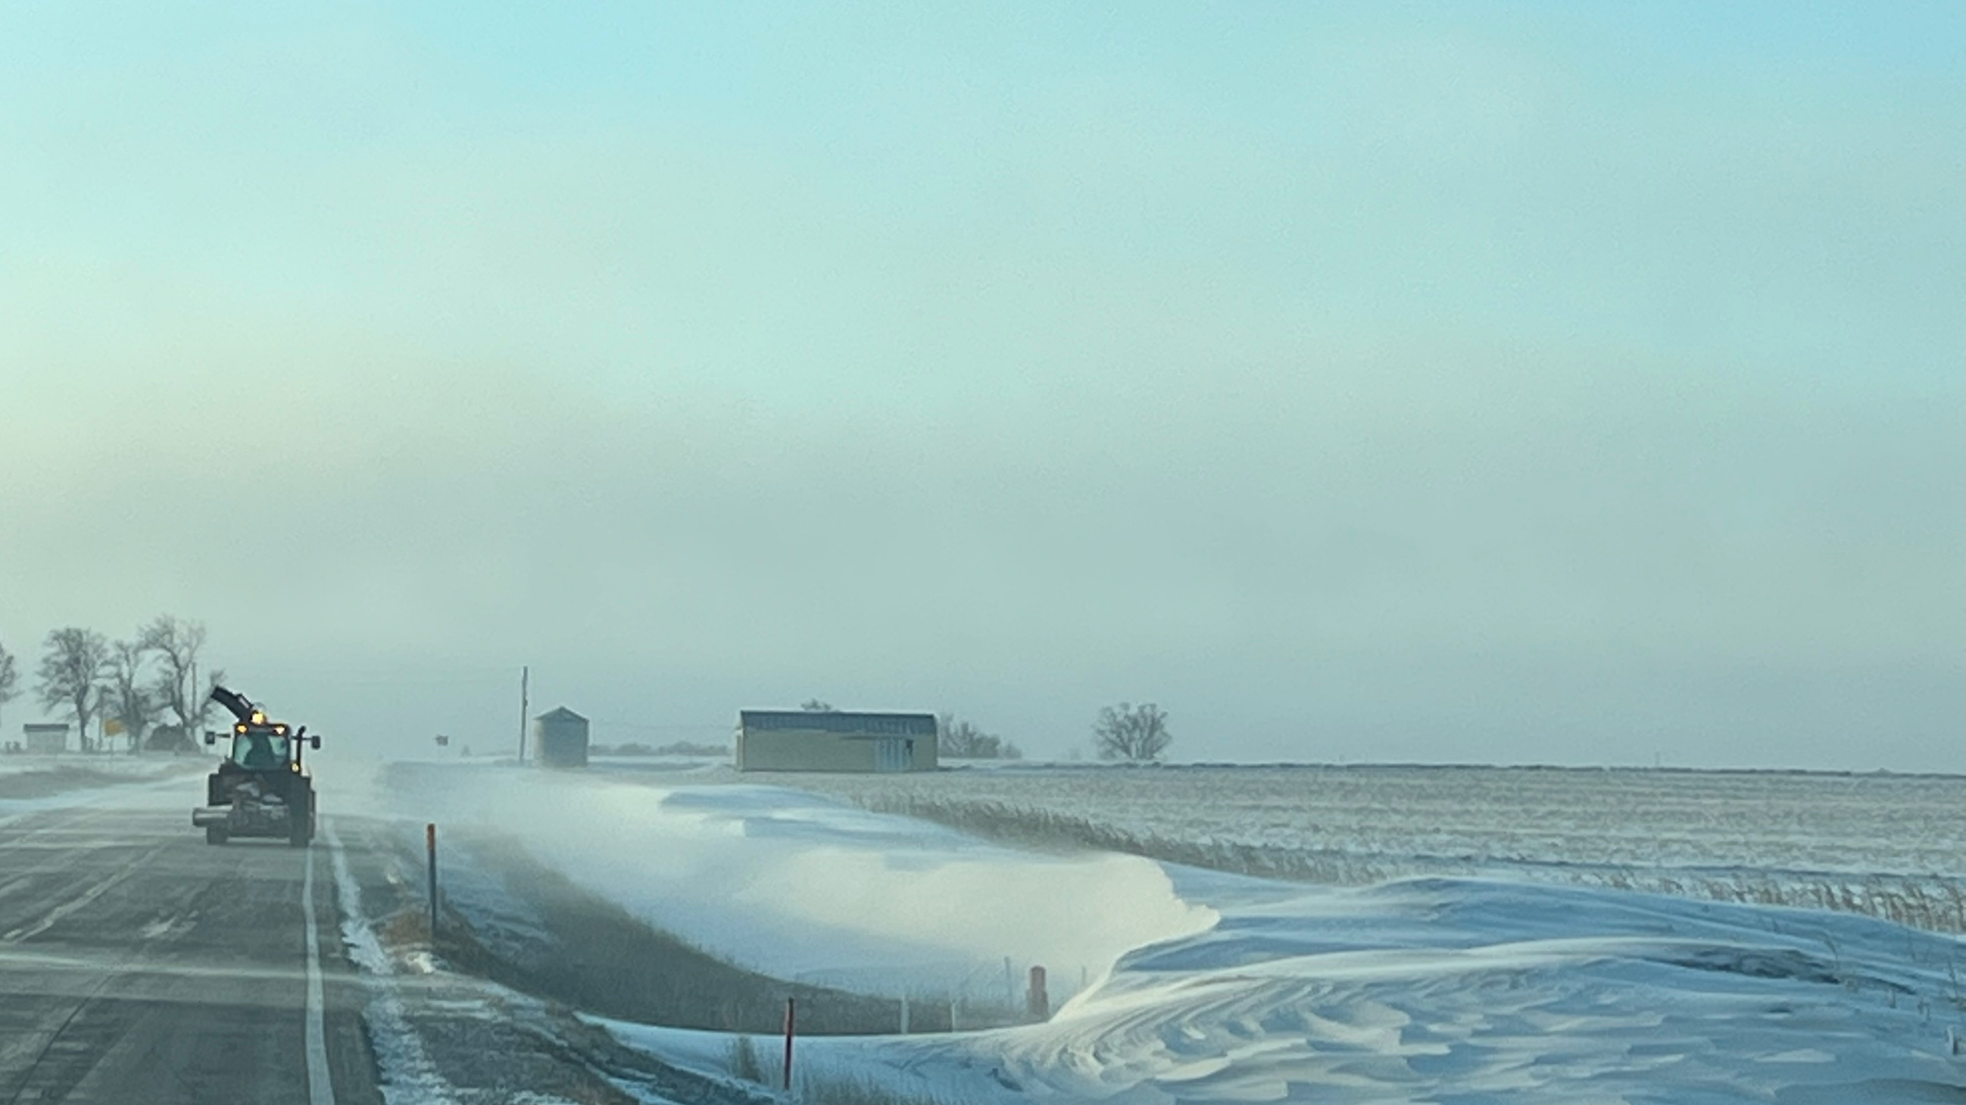
Winter Information For Non-Winter Professionals
Pacific Northwest Snowfighters
June 2023

Slide 2
Effective storm coordination, secure resourcing, positive perception, and productive partnerships depend on your ability to communicate important operations information with people who have limited winter maintenance knowledge.

Slide 3
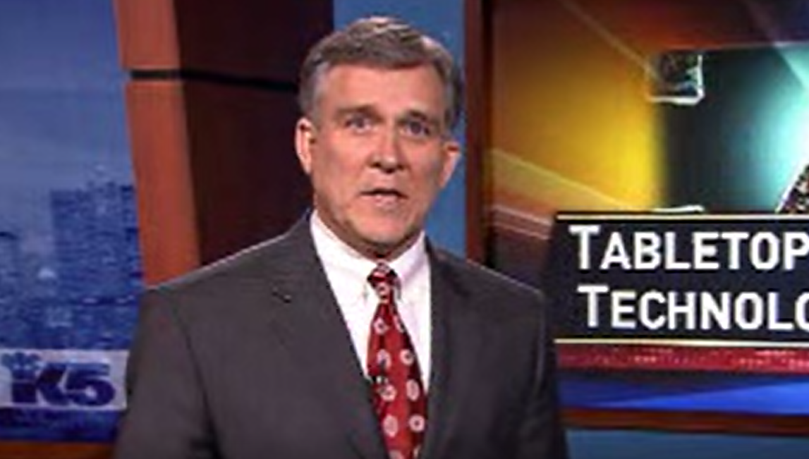
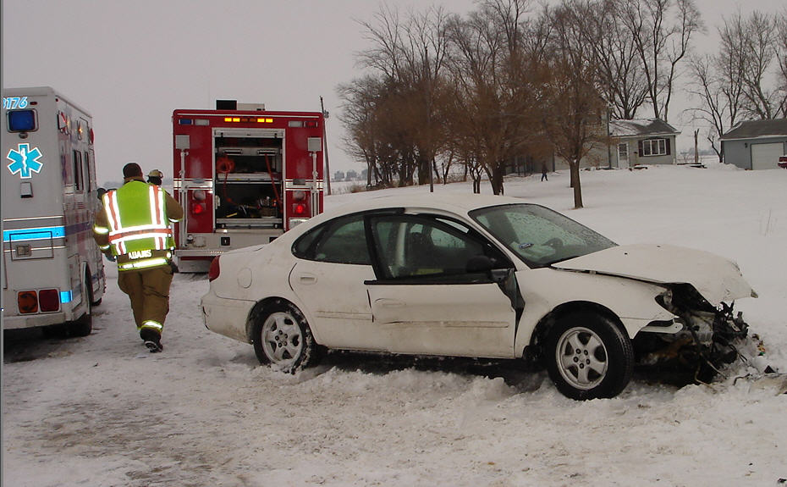
Important Non-Winter Stakeholders
Executive Staff
Agency Media Team
Legislators
Emergency Management Community
Media
Public

Slide 4
Topic Overview
Coordination calls, video emails
Pathfinder, NWS projects
Co-branding, infographics
Public dashboard
Spaghetti charts and winter indices
511 info – plow cams, road conditions, RWIS, road condition automation

Slide 5
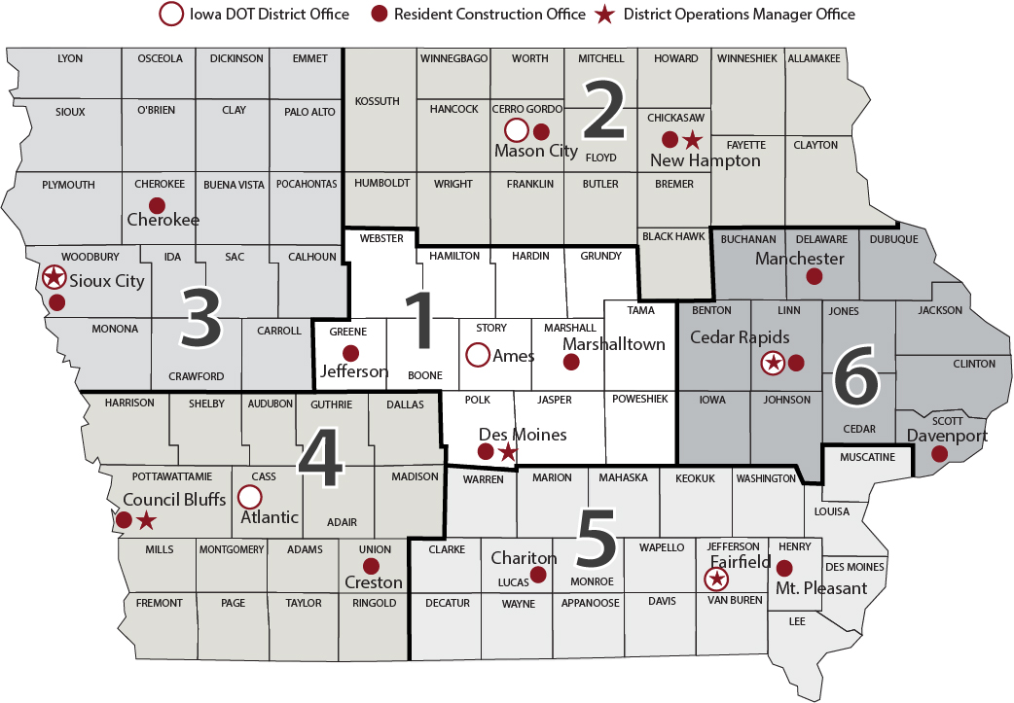
About Iowa DOT
6 Districts
100 maintenance garages
24,500 lane-miles of roadway, 24-hour operation
Approx. 840 full-time operators
Approx. 500 seasonal operators
5-year average material:
156,600 tons salt
31.5 Million gallons brine
21,600 tons sand

Slide 6
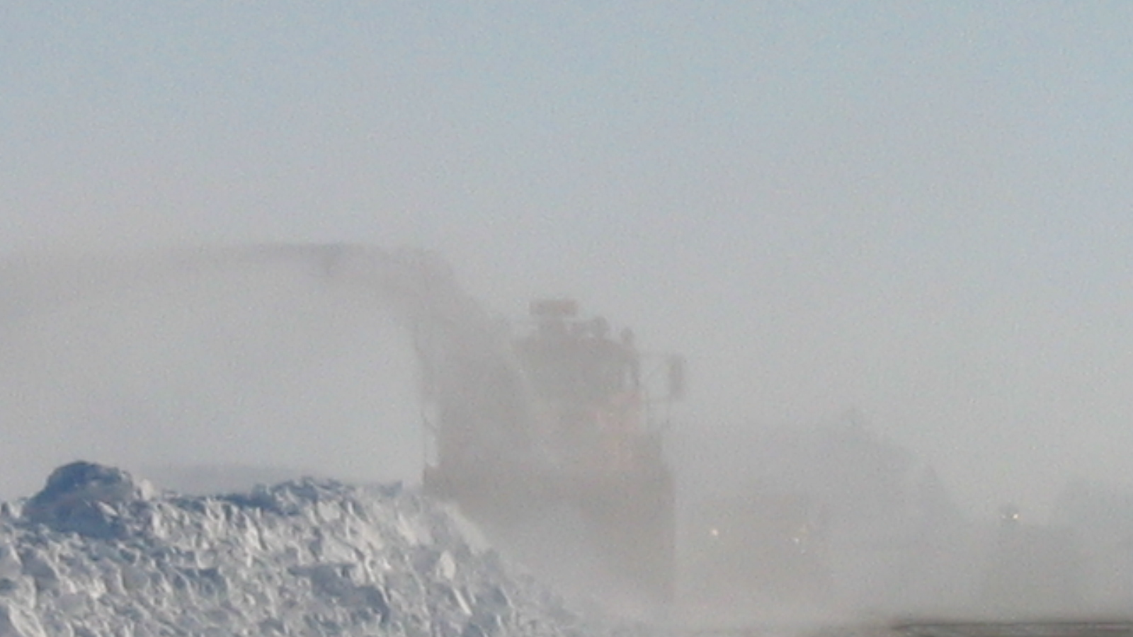
Not So Long Ago….
Public info was always a priority
Efforts to communicate with others outside “operations” was not

Slide 7
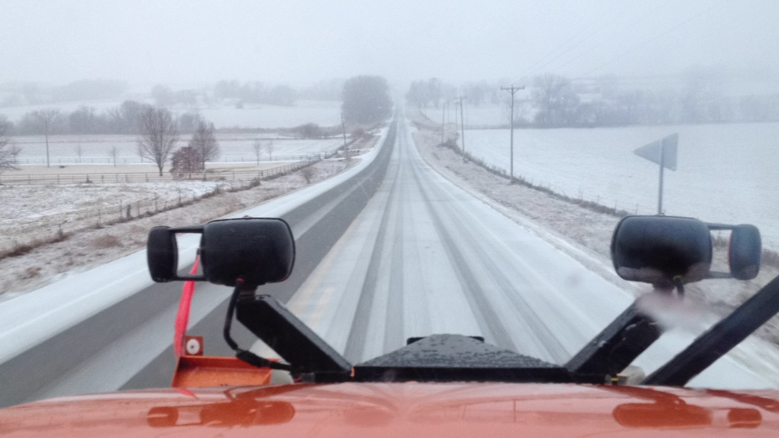
Winter Weather Forecasting for Winter 2021-2022
If a winter weather forecast meets one or more of the following Iowa DOT provided criteria…
Winter Event Forecast Criteria:
6 inches of Snow or greater
¼ inch of Ice or greater
Potential Blizzard Conditions
Winter Storm Watch
…DTN will produce a video forecast for the upcoming Winter event.

Slide 8
Winter Forecast Event Distribution List
Winter Event video forecast is emailed by DTN to the Winter Operations Group:
DOT Executive Leadership Team
Office of Maintenance
Traffic Operations
District Leadership
Garage Supervisors, GOA’s & EO Seniors
Motor Vehicle Enforcement
Strategic Communications
Iowa DOT IT Staff
HSEMD
DPS/Iowa State Patrol
Federal Highway-Iowa Staff
Department of Administrative Services
Governor’s Office
DTN posts this video forecast to their website

Slide 9
Executive Briefings -Coordination Calls
Prior to a significant winter event….
DOT- Maintenance Bureau will facilitate either an Executive Level winter event briefing or a full Coordination Call.
The decision will be based on...
Potential impact to the state
Length of storm
Intensity of storm
Potential Interstate/Highway closures
Governor’s Proclamation

Slide 10
Working With NWS and Patrol
NWS has a great outreach and audience
Patrol is an operational partner but also had an untapped media presence

Slide 11
Pre-Season Prep Meeting
How each agency preps for the winter season and winter events
HOW each agency communicates and WHAT they communicate about during an event
Sources of winter weather/travel information
Who to contact for interviews and types of interviews to seek from each
Safety tips when reporting on weather/events along roadway
Encouragement to share agency social media graphics
Notes:
Debbie

Slide 12
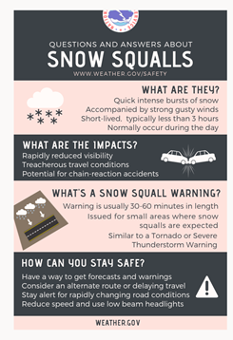
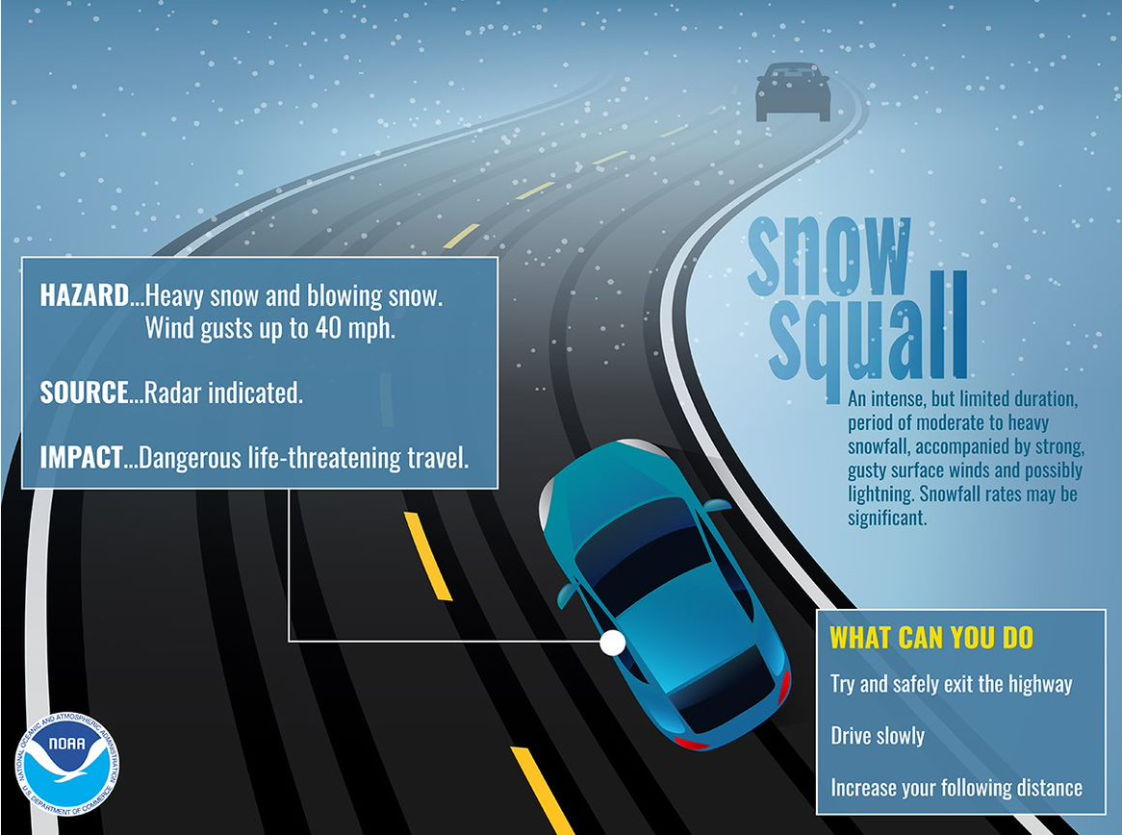
Sharable graphics
One drive with social media and other sharable graphics
Notes:
Andrea

Slide 13
Sharable graphics
One drive with social media and other sharable graphics
Notes:
Andrea

Slide 14
Pathfinder and NWS
Our Des Moines office had great interest in winter crashes as it related to various storm conditions
They can’t give ‘pavement forecasts’ but road impact knowledge helps focus their message

Slide 16
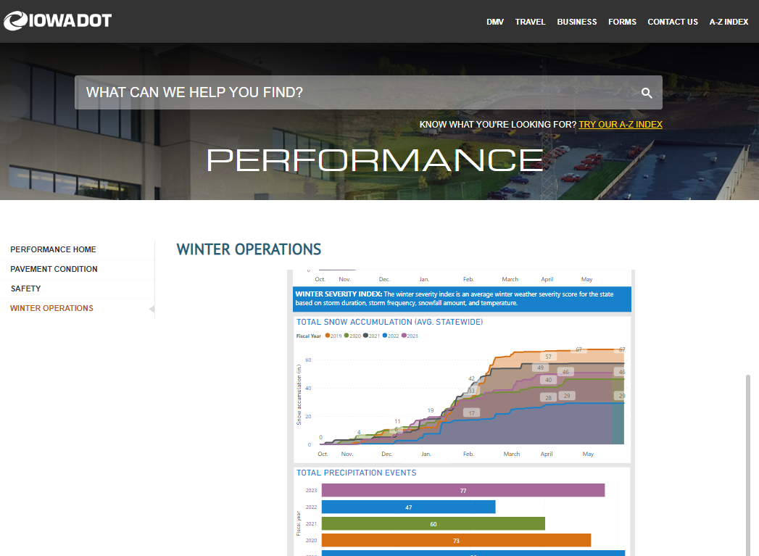
Public-Facing Winter Operations Stats
https://iowadot.gov/performance/winter-operations
Anyone can look up common winter stats
Media stories
Support for legislative requests
Executive staff
Updates daily
Preemptively answers a lot of questions

Slide 17
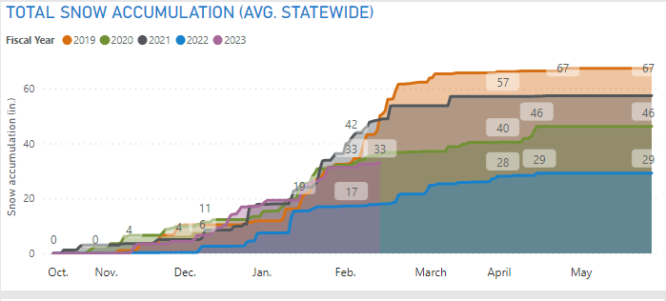

Slide 18
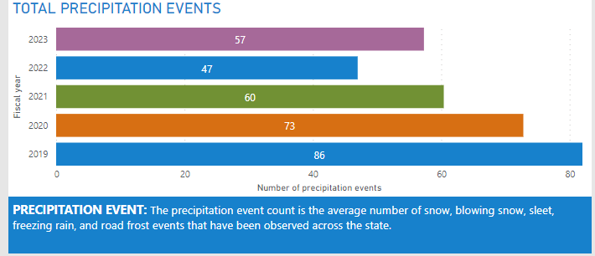

Slide 19
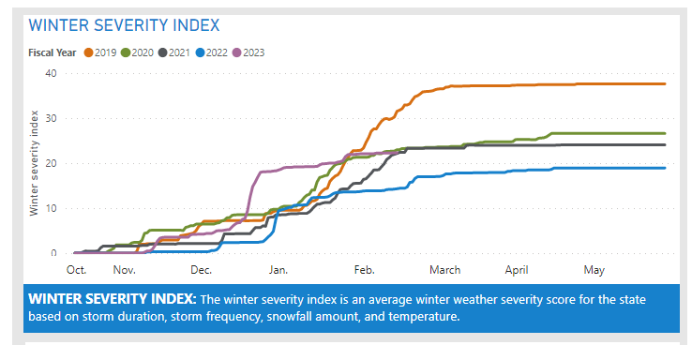
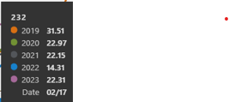
The historical context of many of these graphics tell a useful story

Slide 20
Stats for Decision-makers
Weather severity scores accompany most budget updates or requests
15+ years with the same formula
Weather index scores are abstract, but consistency helps understanding
Focus on key data
1 page only!

Slide 21
Winter Operations Summary as of 14 February 2023
Total Equipment Hours = 144,558.6
Total Equipment Costs @ $31 per hour = $4,481,316.60
Total Labor Hours = 206,326.4
Total Labor Costs @$42 per hour = $8,665,708.80
Materials
Rock Salt – 83,570 tons @ $83.11 per ton = $6,945,503
Sand – 10,606 tons @$14.95 per ton = $158,560
50/50 (Salt/Sand) – 8.207 tons @ $49 per ton = $420,389
Salt Brine – 21,702,096 gallons @$0.20 per gallon = $4,340,419
Calcium Chloride – 14,355 gallons @$1.20 per gallon = $17,226
Total Material Costs = $11,864,097
Total Winter Operations Costs as of 14 February 2023 = $25,011,122

Slide 22
(2-14-23)
Notes:
This graph looks at crashes with snowplows – rear end or sideswipe in the same direction of travel only. These are the crashes we can presumably influence with better rear-facing lighting or advance warning. In this graph, big numbers are good (more hours between hits).
We use crash rate because every winter is different. Sometimes we have to be out there a lot, which increases our exposure to a crash and our overall crash number goes up. On quiet winters our crash number will naturally be lower. The rate comparison to our active hours helps remove the influence of how busy our winter was, so we can look at the trends that we are interested in – especially whether our safety initiatives are working.
FY15 and prior we were using only amber warning lights. In FY16-18 we were allowed to test some blue-white-amber patterns as part of an effort to allow such lights on our trucks. The Iowa legislature changed the code in FY18 to allow us to use B-W-A in winter operations only, and by FY19 the entire snowplow fleet was equipped. Our crash rates seemed to improve.
In recent years, however, our crash rate has deteriorated.

Slide 23
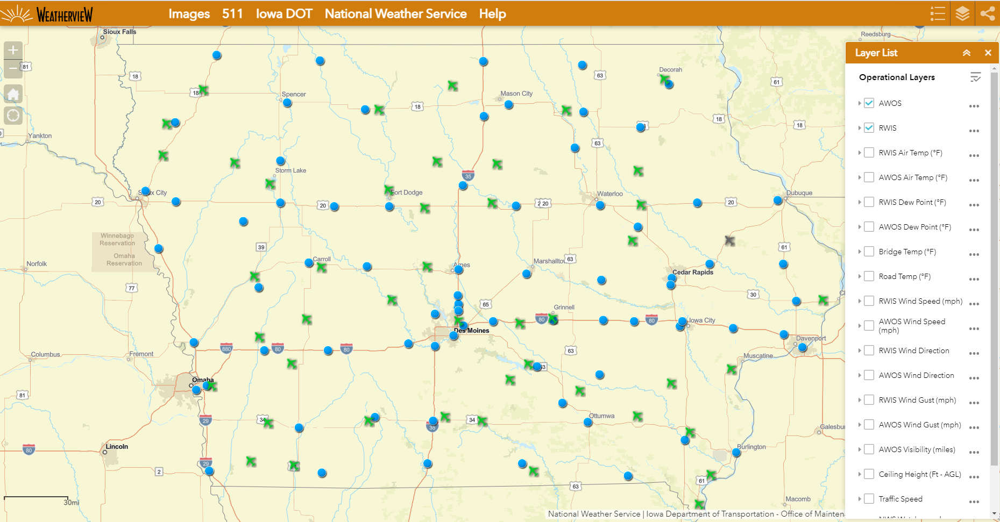
Public Travel Info
www.511ia.org is our primary traveler outreach platform
Also very active on social media. Actively monitor for storm-related chatter
https://weatherview.iowadot.gov is a secondary site for more detailed RWIS/AWOS data

Slide 24
511
Road condition reports
Plow cameras
Plow locations
RWIS data
Traffic cams

Slide 26
Basic NWS forecast and nearby plow images accompanies road report

Slide 27
How This Helps
Fewer questions -- Info stakeholders can look up on their own
Help from agencies with a bigger or different audience from ours
Media and management prepped prior to most issues
Management knows our decisions are not made randomly. Data supports our requests.
Goodwill –people appreciate weather updates and being considered in planning

Slide 28
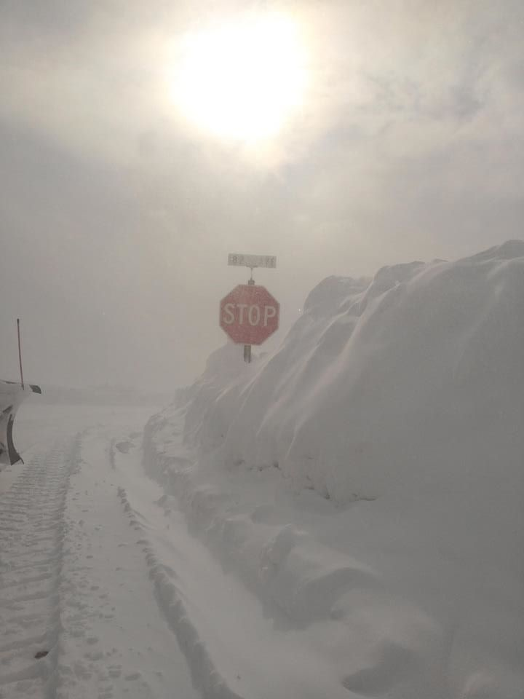
Thanks!
Tina Greenfield
Iowa DOT
Tina.greenfield@iowadot.us

